Slide 1
Kubernetes / EKS
Container Orchestration Engine
Raushan Kumar

Slide 2
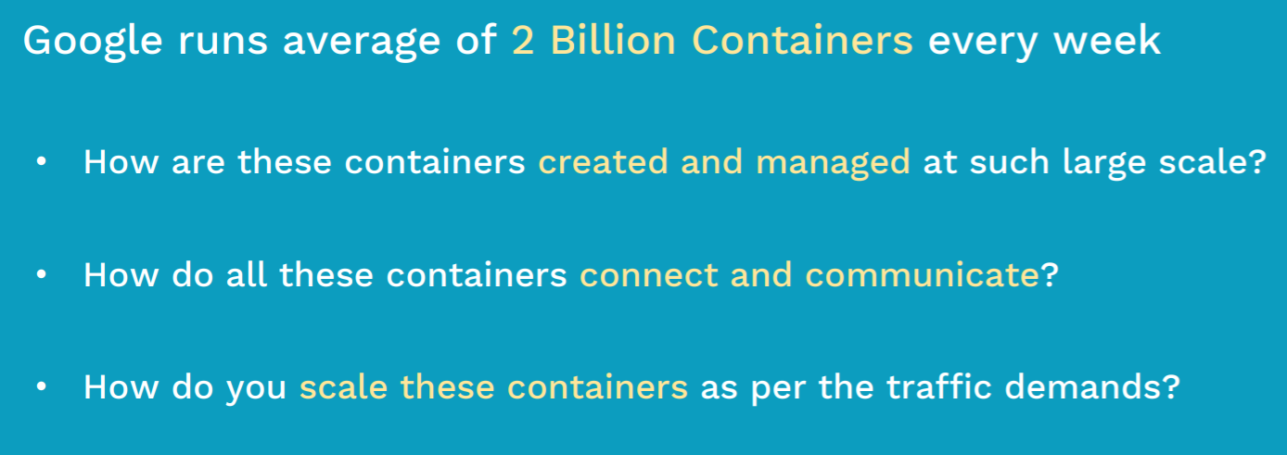
Fact & Problem Statements
Raushan Kumar

Slide 3
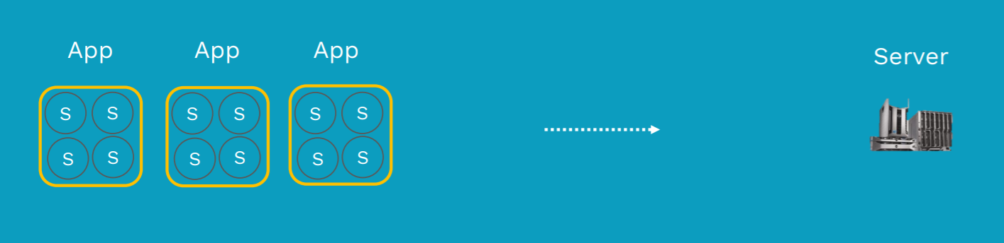
COE is not always required
Use-case: Start-up/small companies running 3-4 applications with few microservices.
Can be handled by Load-Balancer & Auto-Scaling Groups
Raushan Kumar

Slide 4
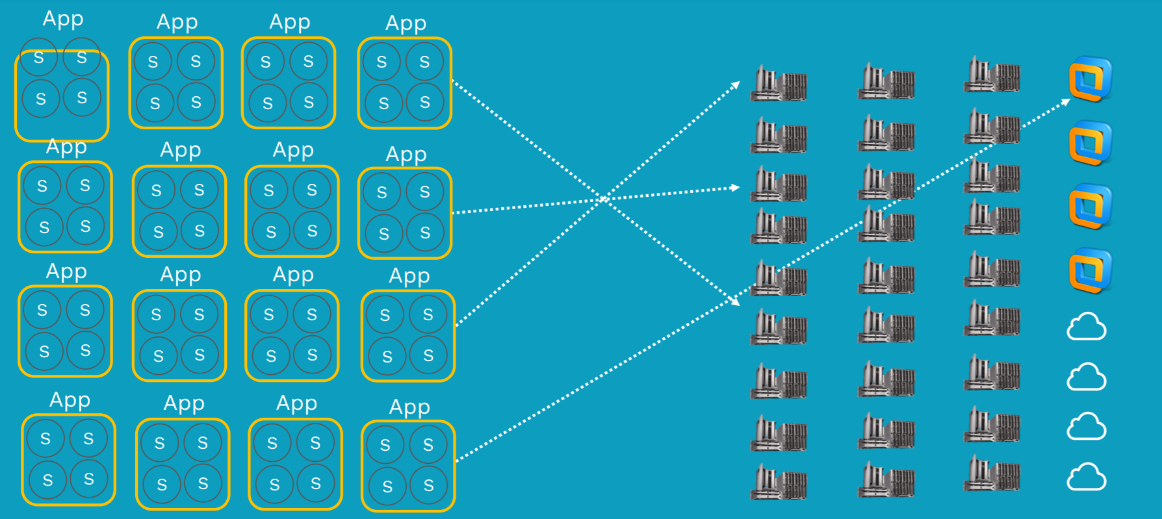
Here is the problem - Clustering & Scalability & Solution
Solution: Container Orchestration Engine
Raushan Kumar

Slide 5
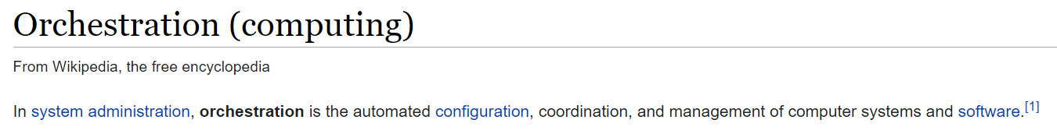
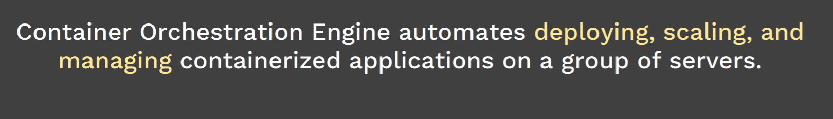
Container Orchestration Engine
Raushan Kumar

Slide 6
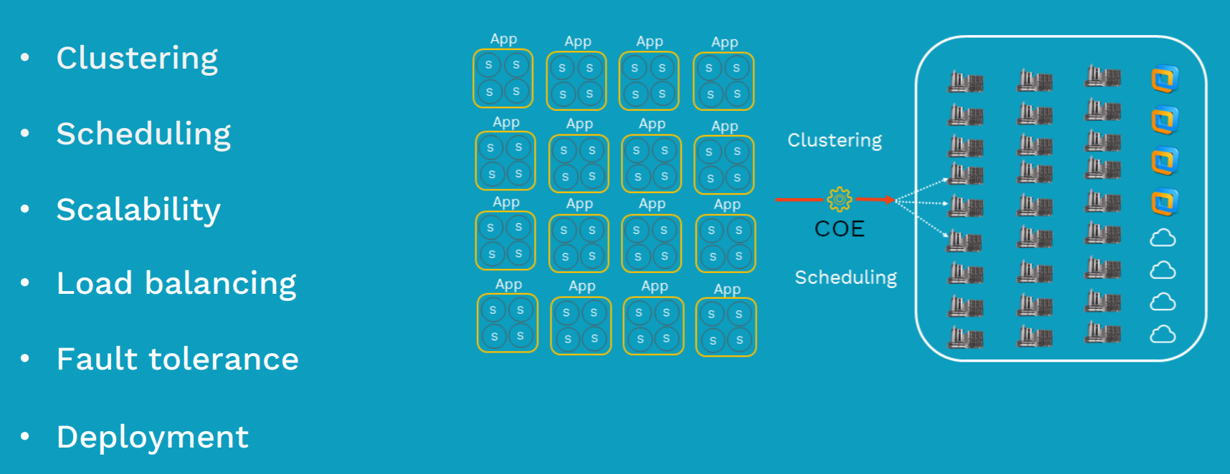
COE Features
Raushan Kumar

Slide 7
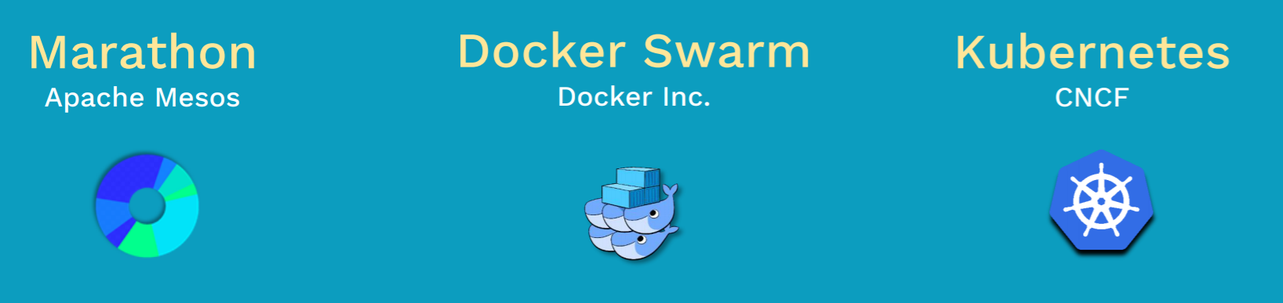
TOP-3 Container Orchestration Engine
Used by Large Enterprises
Requires lot of compute such as Big Data
Raushan Kumar

Slide 8
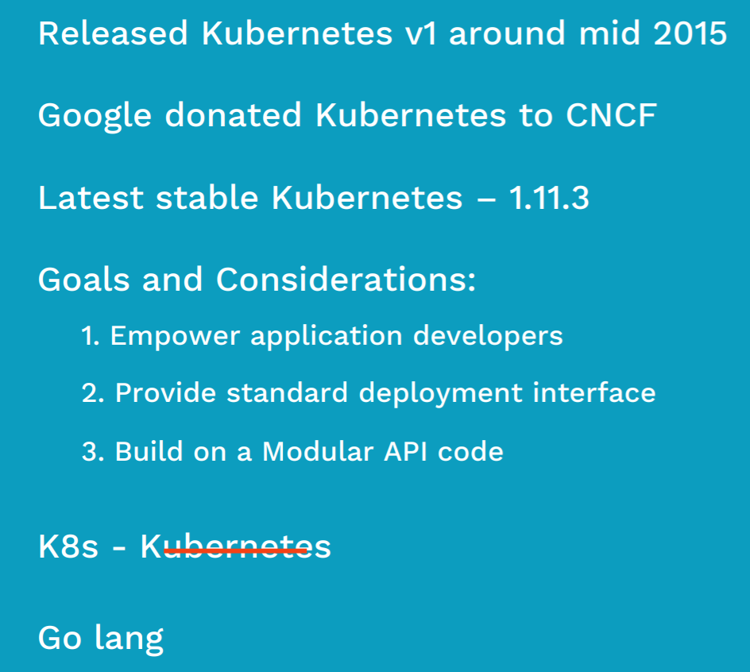
Kubernetes
Raushan Kumar

Slide 9
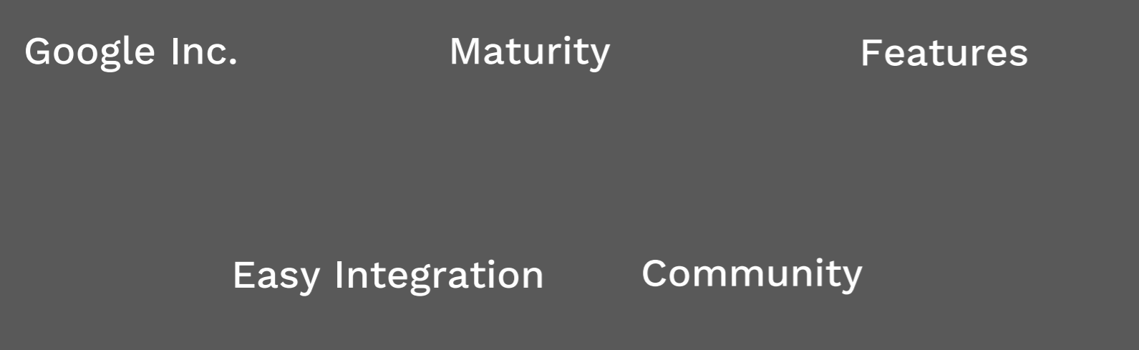
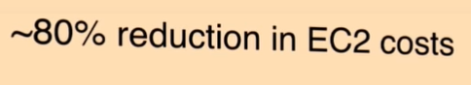
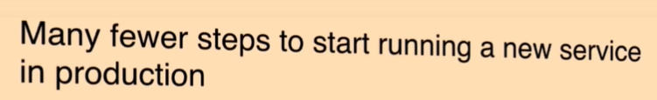
Why Kubernetes
Raushan Kumar

Slide 10
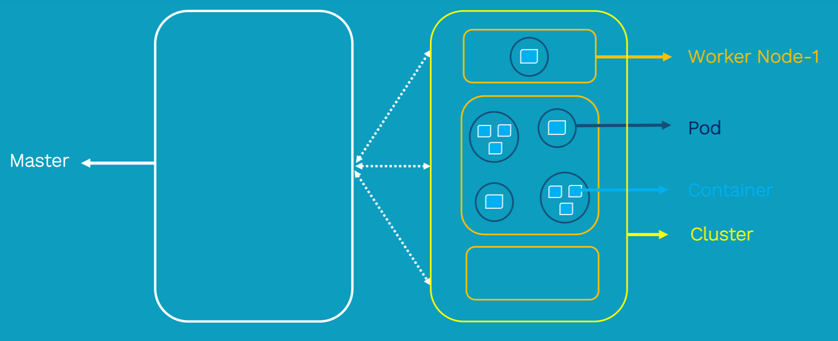
Kubernetes Overview
Raushan Kumar

Slide 11
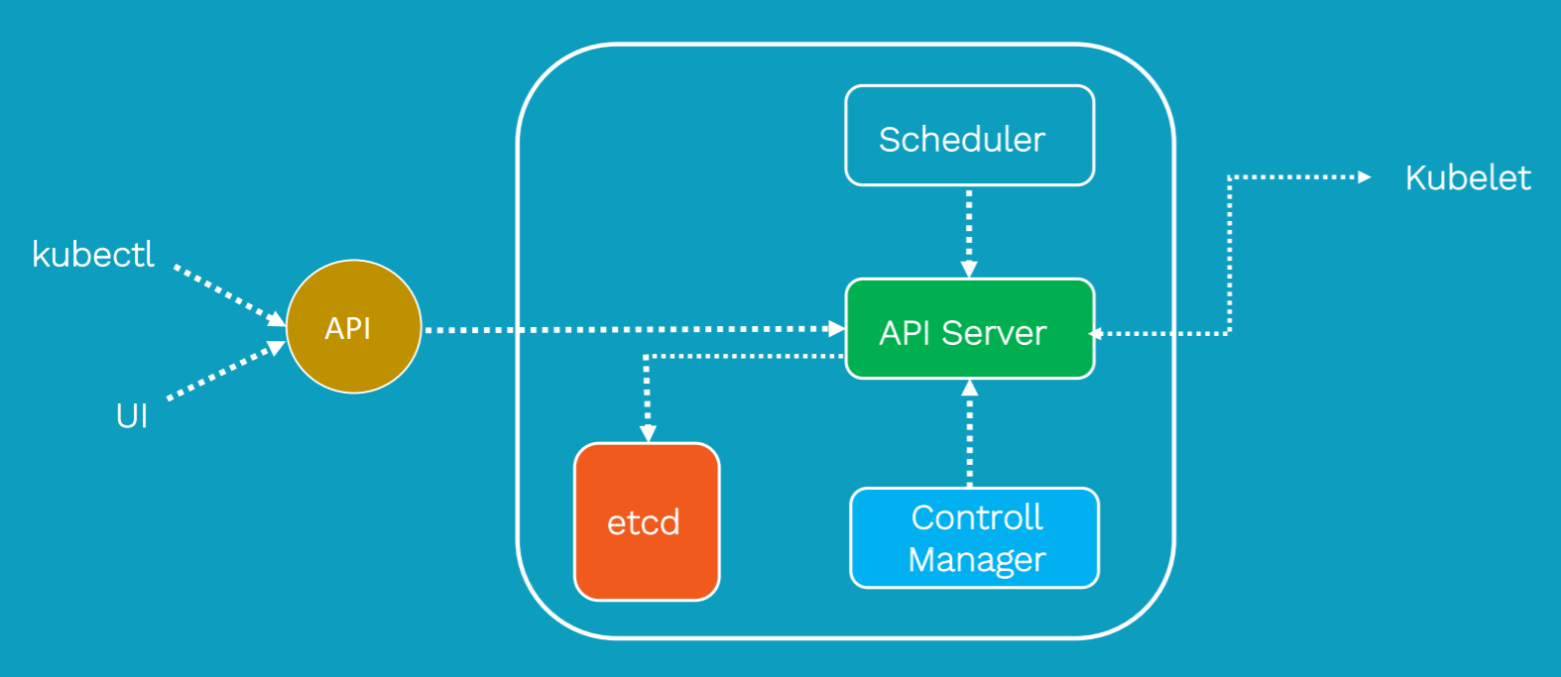
Kubernetes Architecture - Master
API Server: It is kind of a Gate Keeper for the entire Cluster.
In case, you want to create, update, delete or even display any Kubernetes object inside the Kubernetes Cluster, it has to go through the API Server.
It validates and configures the API objects that we submit.
These API objects can be Pods, Services, Replication Controllers, Deployments, etc.
We interact primarily with API Server using Kubectl commands.
Scheduler: Responsible for physically submitting Pods across multiple nodes. So, depending upon
the requirement that we submit to the API Server, Scheduler will schedule Pods accordingly.
Control Manager: Responsible for overall health of the entire Cluster. It ensues that nodes inside the cluster are up and running and correct number of pods are running, as mentioned in the spec file.
ETCD: Is a distributed key value lightweight central database to store current state of the cluster at any point of time. Your cluster information, nodes, secrets, controllers and other object configuration is stored inside this. Any component of the Kubernetes can query to understand the state of the cluster. So, it is going to be a single source of truth inside the kubernetes cluster.
Raushan Kumar

Slide 12
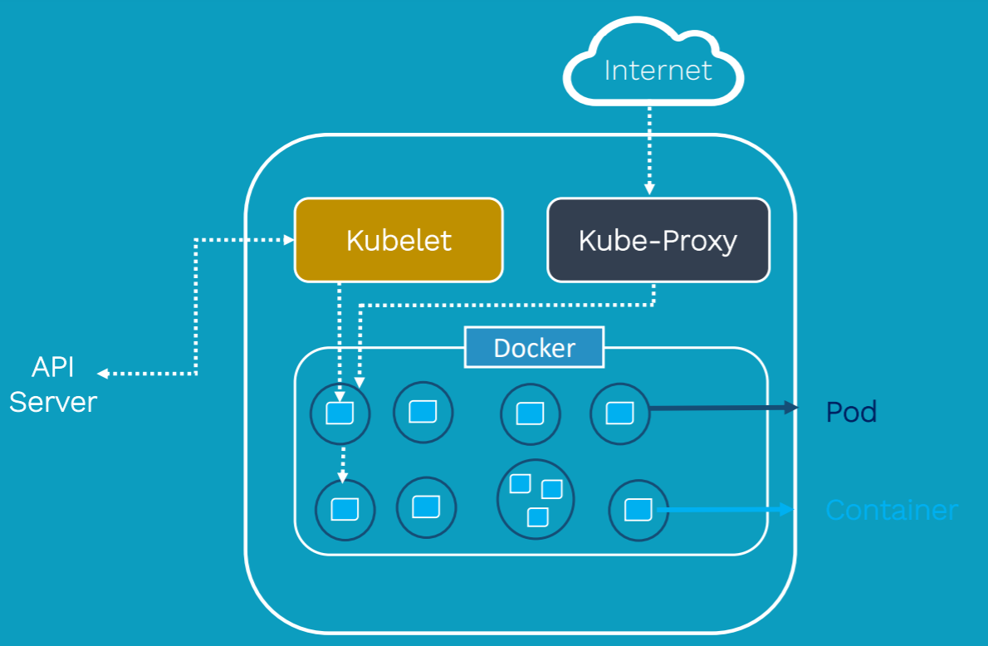
Kubernetes Architecture - Worker
Kubelet: Looks at the pods spec that was submitted
to the API Server and ensures that containers
described in that pods spec are running successfully
And healthy. In case, Kubelet notices any issues with
those pods then it tries to restart those pods on same node. In case, if the issue is with node, master detects a node failure and launches the pods onto another healthy node.
Kube-Proxy: Responsible for maintaining the entire network configuration. It essentially maintains the distributed network across all the nodes, pods and containers. It also exposes the Services. It is essentially the core networking component of the Kubernetes.
Pods: are basically scheduling units in Kubernetes. Each Pods consist of 1 or more containers. In most cases, there will be
1 container. There are scenarios, where we need to run 2 or more dependent containers together within a Pod, where
1 container will be helping another container. In Kubernetes, we primarily interact with Pods than Containers.
Each Pod has unique IP address inside the Kubernetes Cluster.
Raushan Kumar

Slide 13
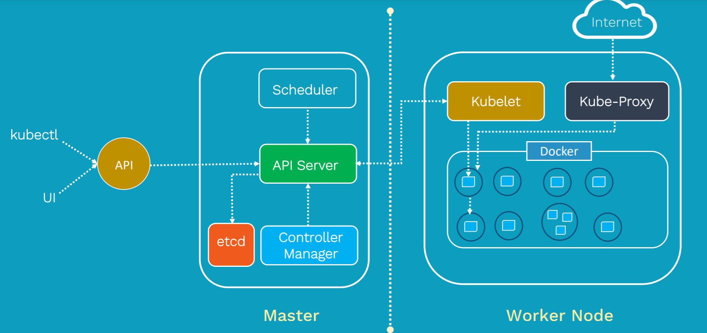
Kubernetes Architecture
Raushan Kumar

Slide 14
Kubernetes Architecture - Details
Currently, Kubernetes supports up to 5000 worker nodes per cluster.
Ideally, in an application architecture, there is more than 1 Master Node for
High availability and Fault Tolerance.
In early days, these worker nodes/nodes are also called Minions.
Containers are designed to run MicroServices, not Monolithic applications.
Raushan Kumar

Slide 15
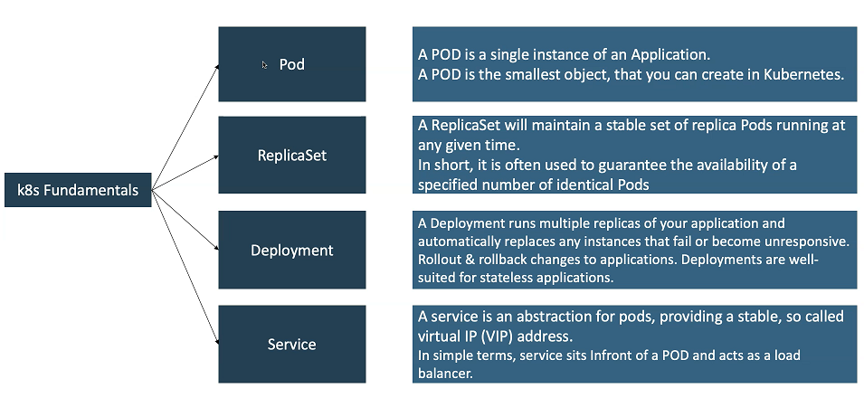
Kubernetes - Fundamentals
Raushan Kumar

Slide 16
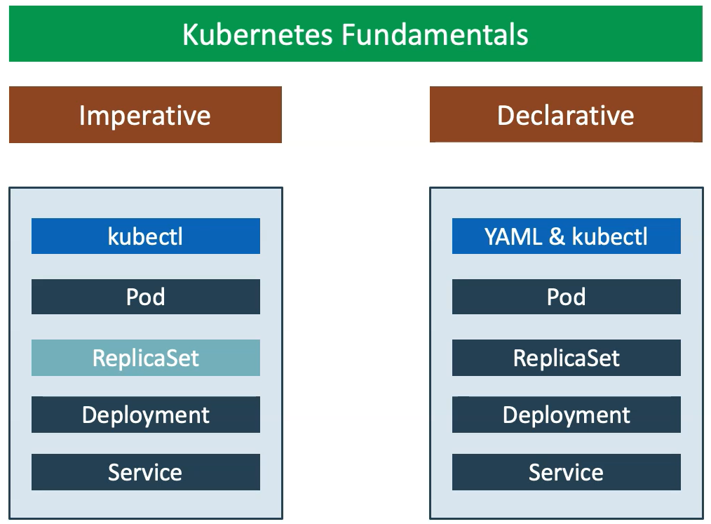
Kubernetes – Imperative & Declarative
Raushan Kumar

Slide 17
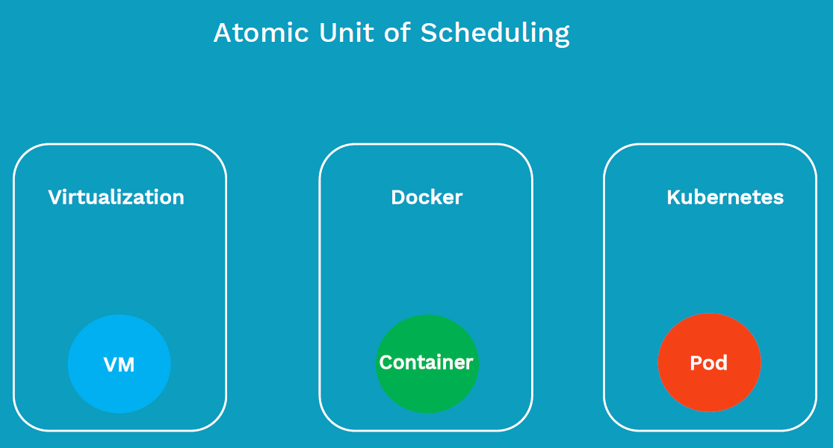
What is Pod?
Raushan Kumar

Slide 18
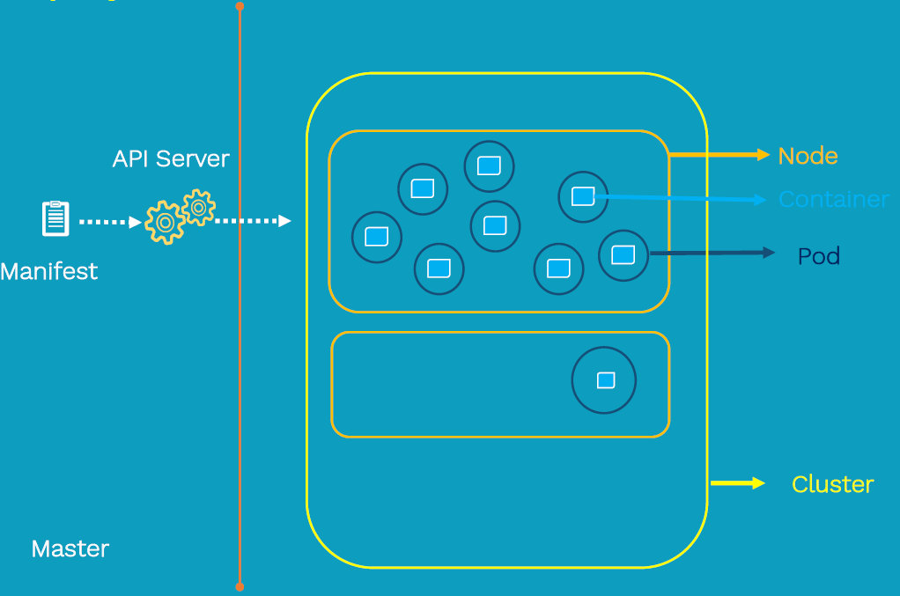
POD Deployment
Raushan Kumar

Slide 19
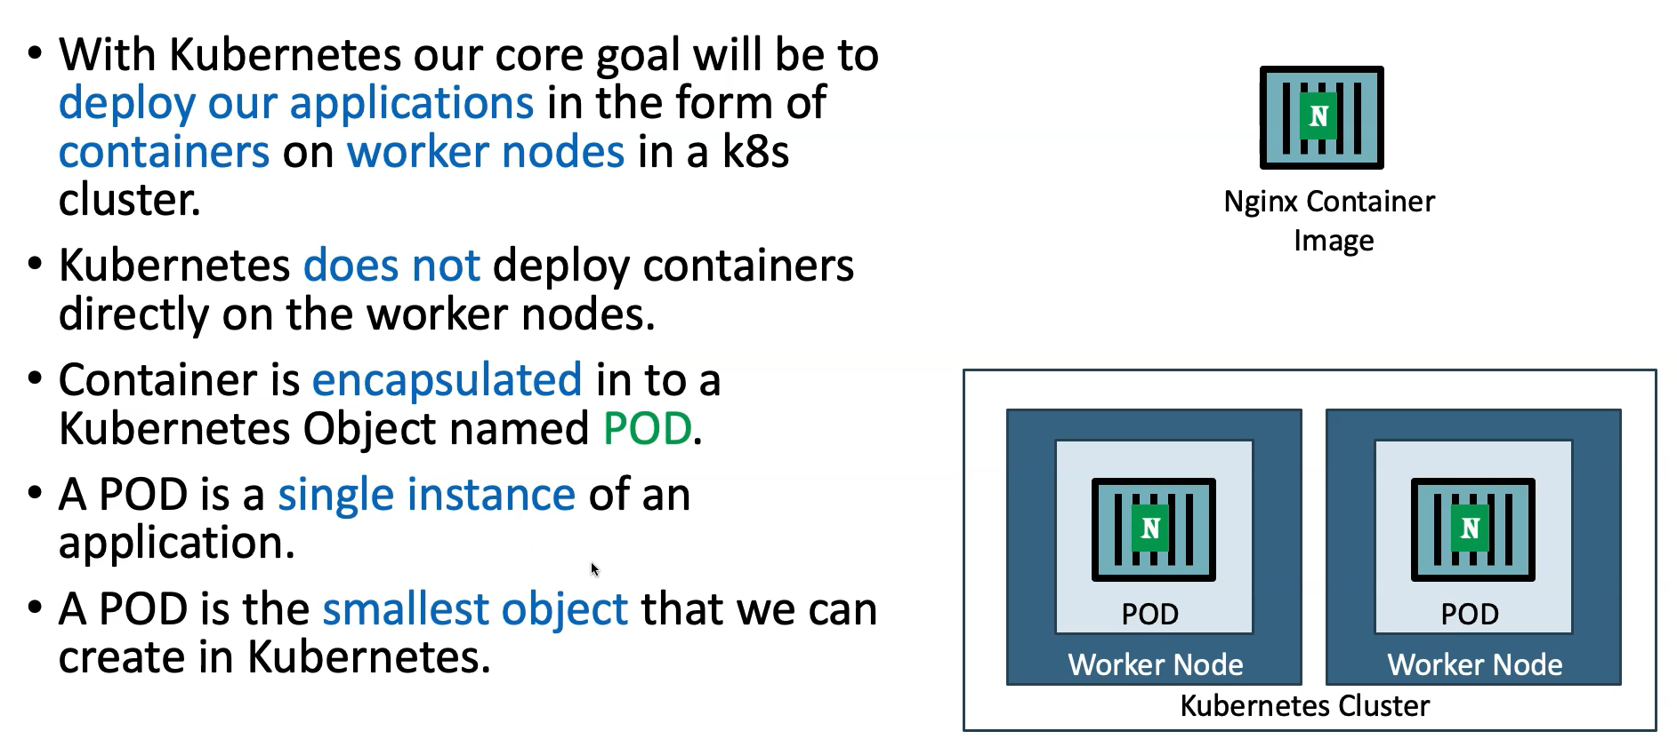
Kubernetes – POD
Raushan Kumar

Slide 20
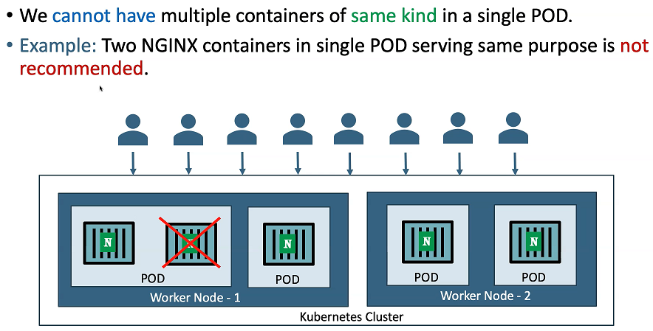
Kubernetes – POD
Raushan Kumar

Slide 21
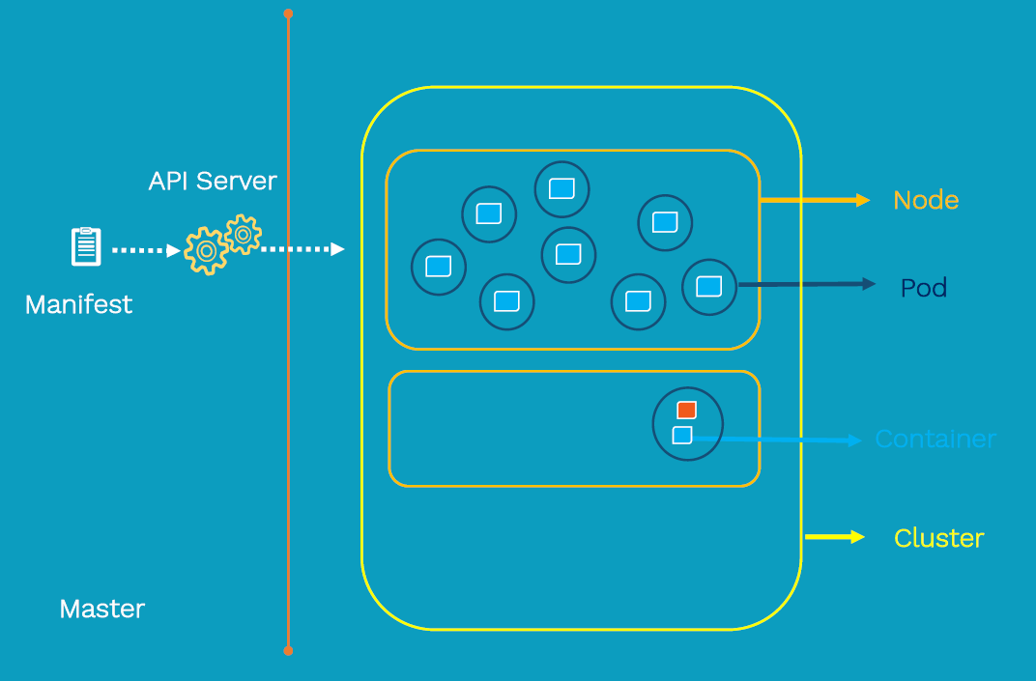
Kubernetes – Multi-Container POD
Raushan Kumar

Slide 22
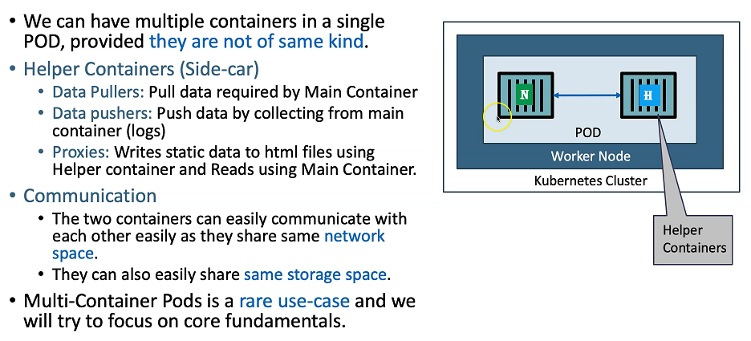
Kubernetes – Multi-Container POD
Raushan Kumar

Slide 23
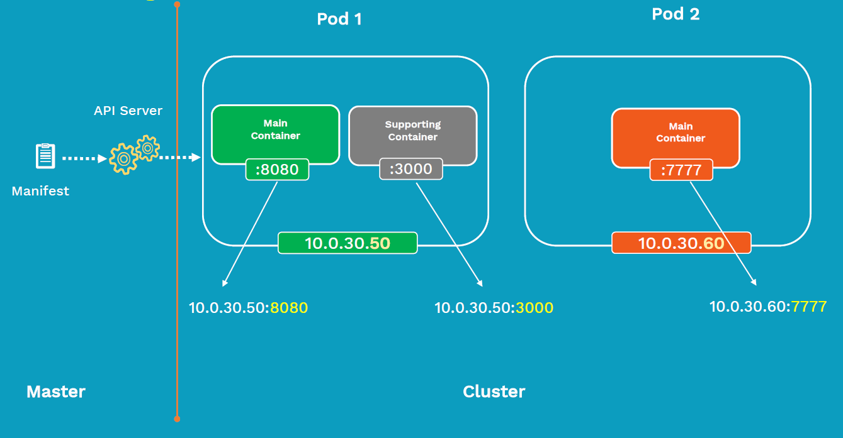
POD Networking
Raushan Kumar

Slide 24
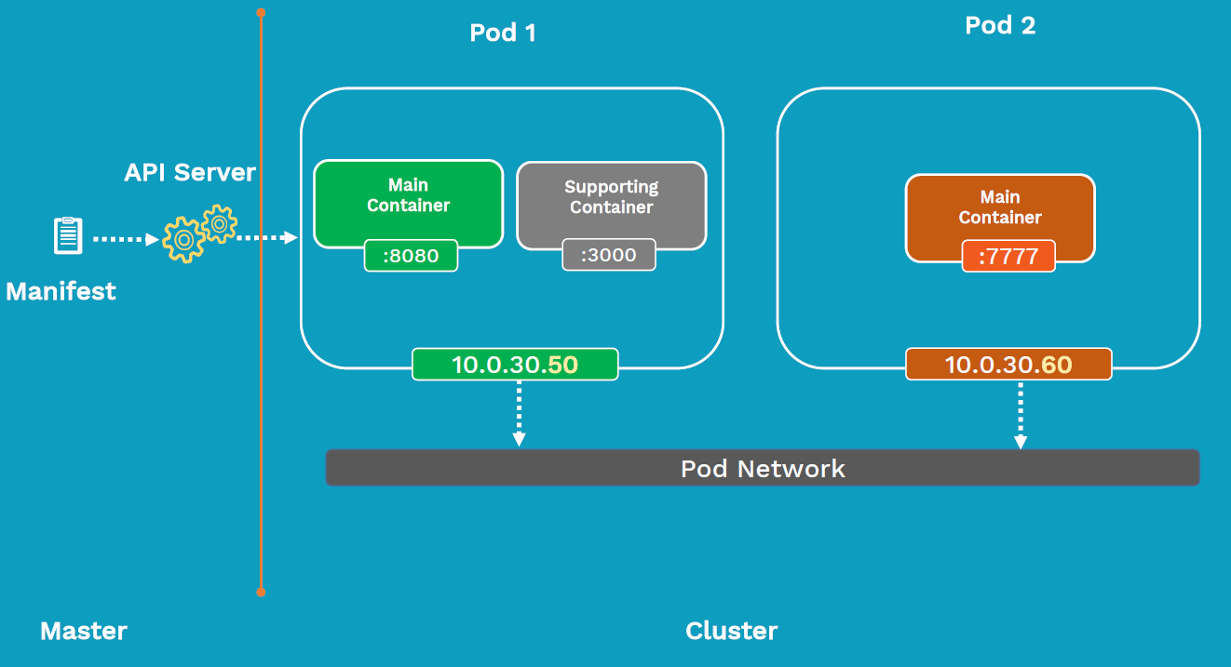
Inter-Pod Communication
Raushan Kumar

Slide 25
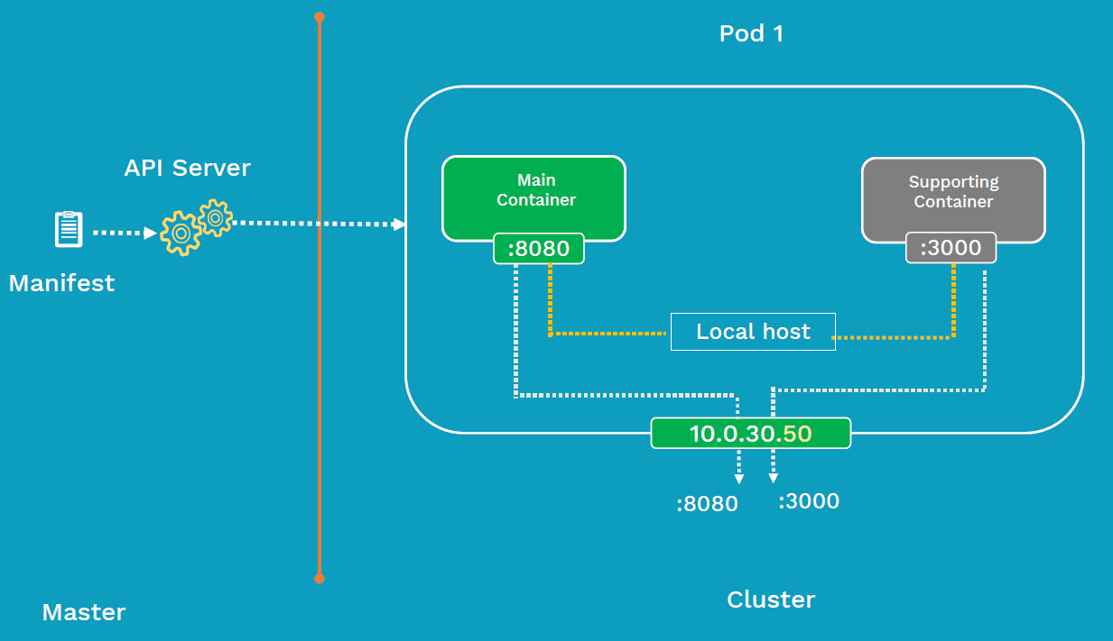
Intra-Pod Communication
Raushan Kumar

Slide 26
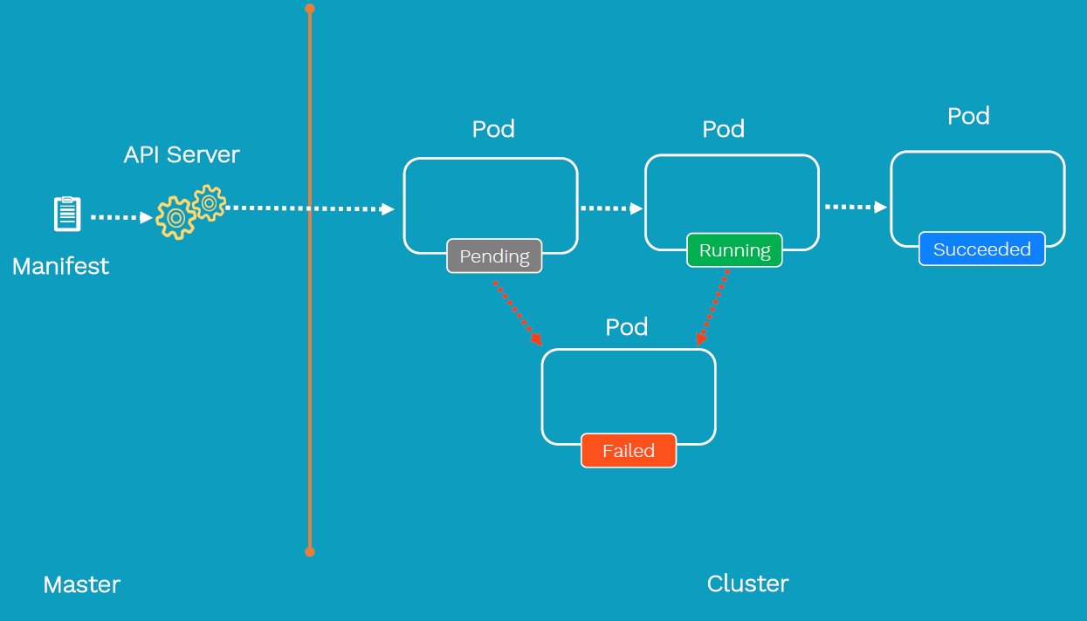
Pod Lifecycle
Raushan Kumar

Slide 27
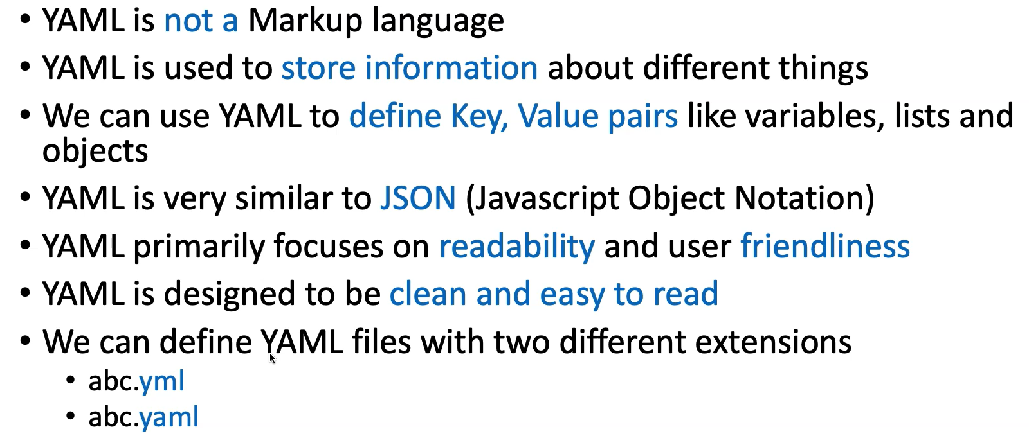
YAML Basics
Raushan Kumar

Slide 28
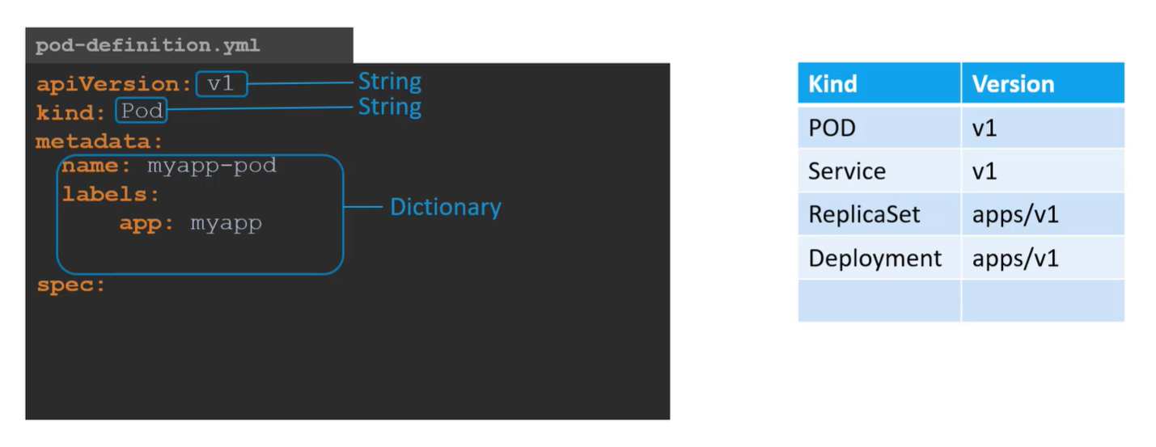
YAML in Kubernetes
Raushan Kumar

Slide 29
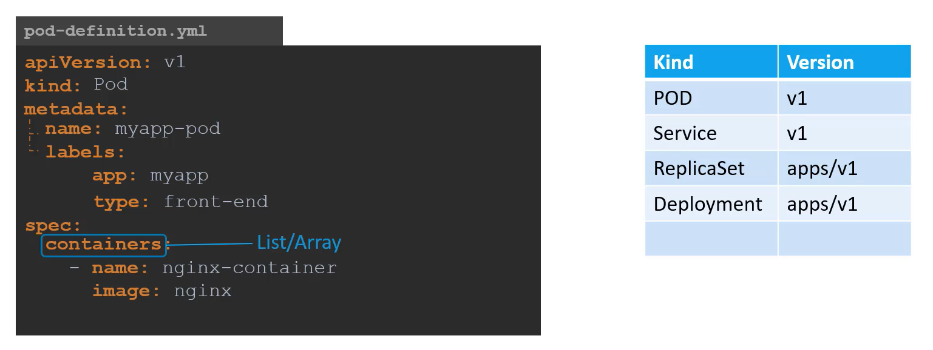
YAML in Kubernetes
Raushan Kumar

Slide 30
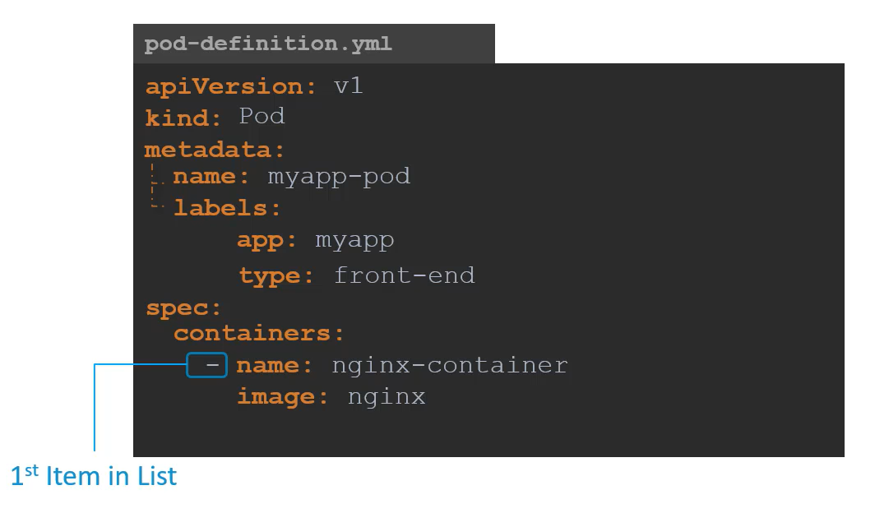
YAML in Kubernetes
Raushan Kumar

Slide 31
Demo: Pods
Create Pod using Command: kubectl run <desired-pod-name> --image <Container-Image> --generator=run-pod/v1
Pod Manifest File – nginx-pod1.yaml
# nginx-pod1.yaml
apiVersion: v1
kind: Pod
metadata:
name: nginx-pod
labels:
app: nginx
tier: dev
spec:
containers:
- name: nginx-container
image: nginx
kubectl create -f nginx-pod1.yaml
kubectl get pods
kubectl get po
kubectl get pods -o wide
kubectl get pod nginx-pod -o yaml
kubectl describe pod nginx-pod
kubectl exec -it nginx-pod -- /bin/sh
kubectl delete pod nginx-pod
Q. How do we access this application externally?
A. NodePort Service
Raushan Kumar

Slide 32
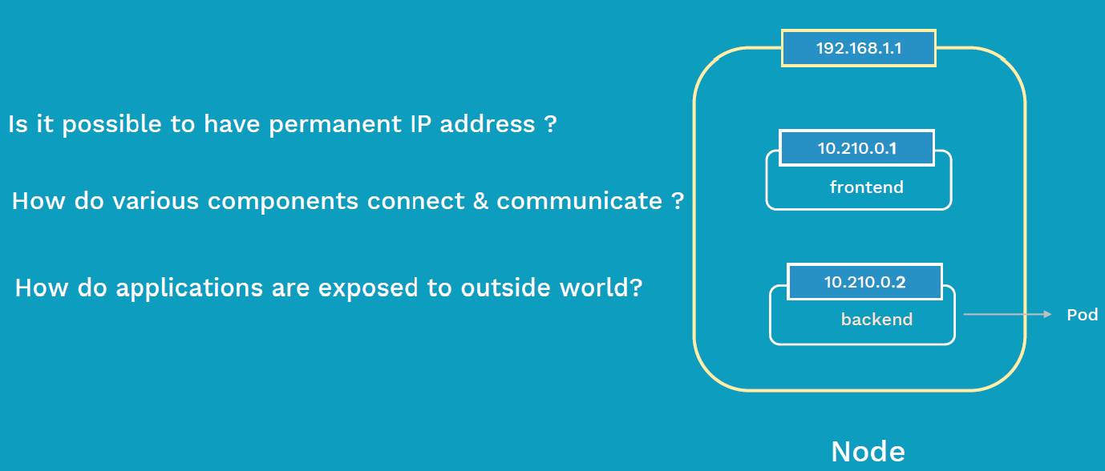
Why Services?
Raushan Kumar

Slide 33
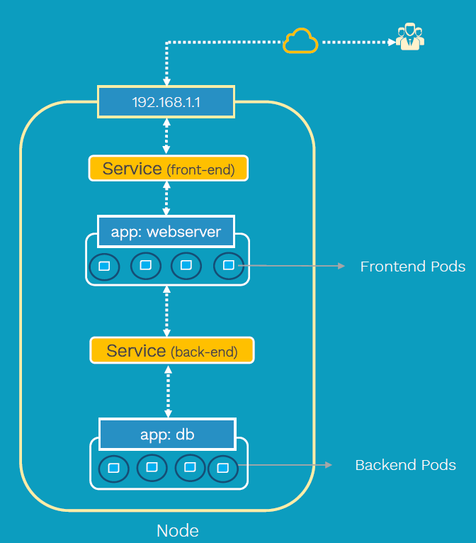
Services
Front-end Service
Back-end Service
Raushan Kumar

Slide 34
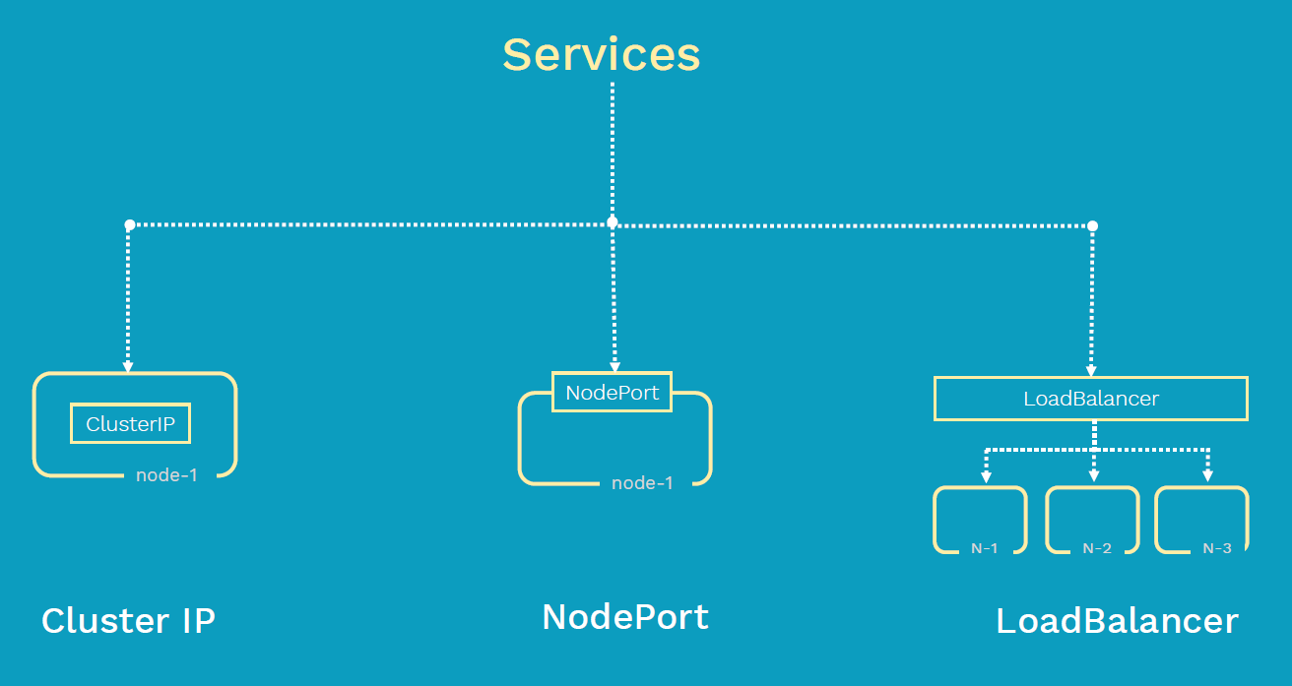
Types of Services
Raushan Kumar

Slide 35
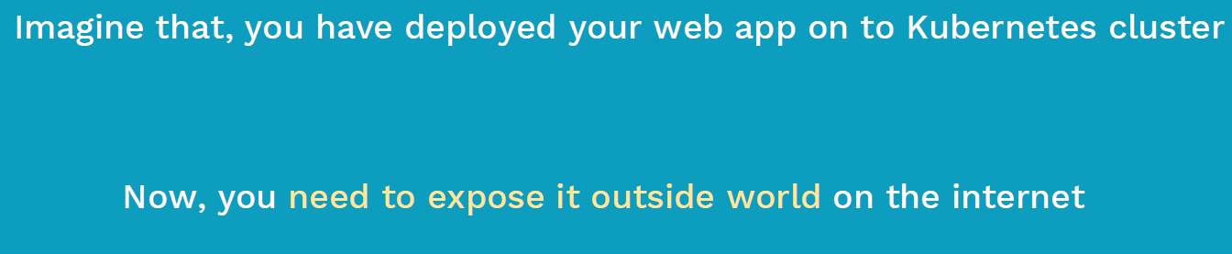
Why NodePort Service?
Raushan Kumar

Slide 36
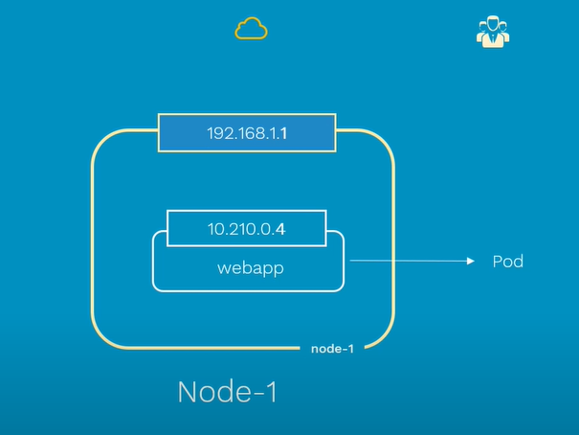
NodePort Service
To access it externally, we need to create a NodePort Service.
Pods are ephemeral
Raushan Kumar

Slide 37
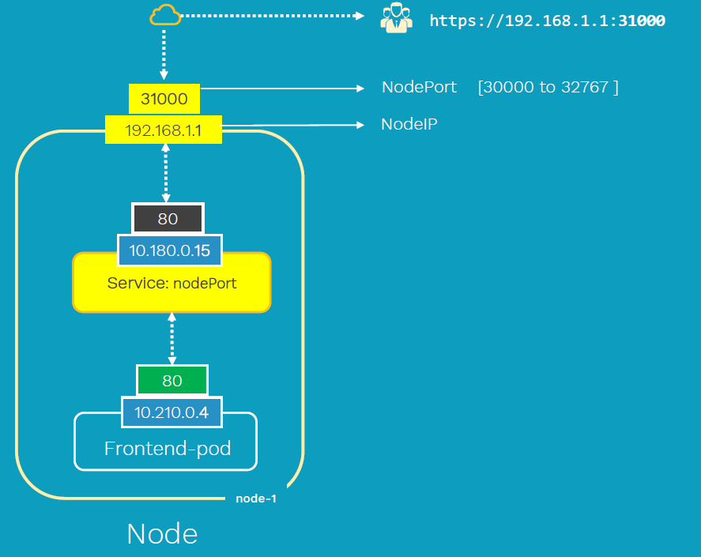
Service Type: NodePort
Raushan Kumar

Slide 38
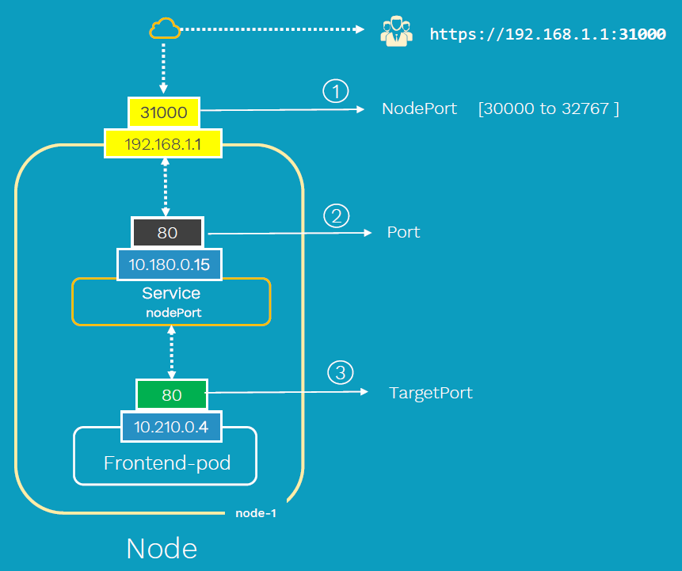
Port Types
Port: Port on which node port service listens in Kubernetes cluster internally
TargetPort: We define container port here on
which our application is running
NodePort: Worker Node port on which we can
access our application
Raushan Kumar

Slide 39
Create a NodePort Service
# Service
# nginx-svc-np.yaml
apiVersion: v1
kind: Service
metadata:
name: myapp-pod-nodeport-service # Name of the Service
spec:
type: NodePort
selector:
# Loadbalance traffic across Pods matching this label selector
app: nginx-container
# Accept traffic sent to port 80
ports:
- name: http
port: 80 # Service Port
targetPort: 80 # Container Port
nodePort: 31231 # NodePort
# Create Service
kubectl apply -f nginx-svc-np.yaml
# List Service
kubectl get svc
# Get Public IP
kubectl get nodes -o wide
# Access Application
http://<WorkerNode-Public-IP>:<NodePort>
http://<WorkerNode-Public-IP>:31231
Raushan Kumar

Slide 40
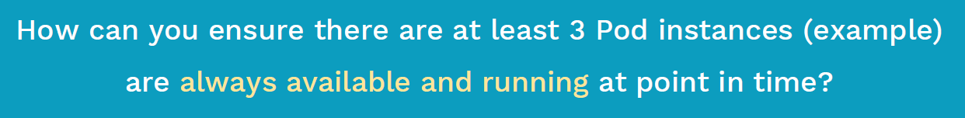
Problem
Now that we have Pods running..
Raushan Kumar

Slide 41
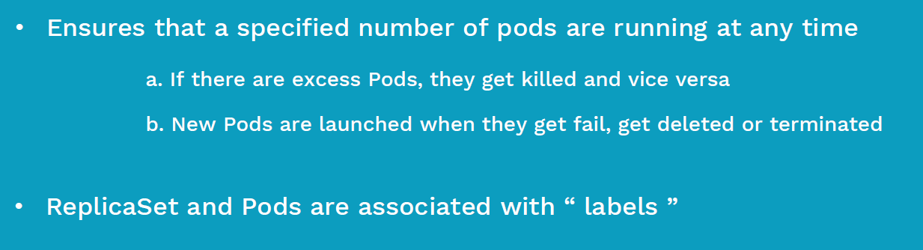
ReplicaSet
Raushan Kumar

Slide 42
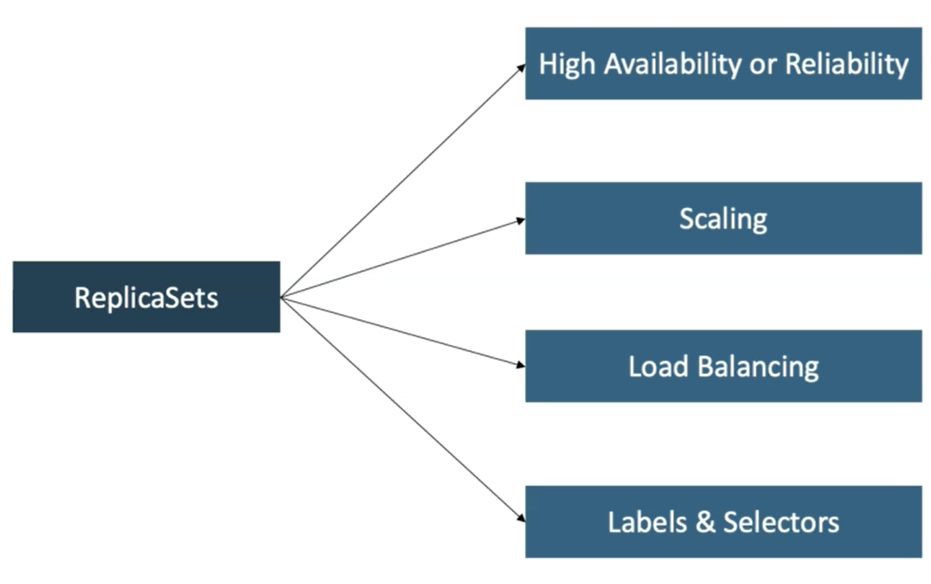
ReplicaSet Advantages
Raushan Kumar

Slide 43
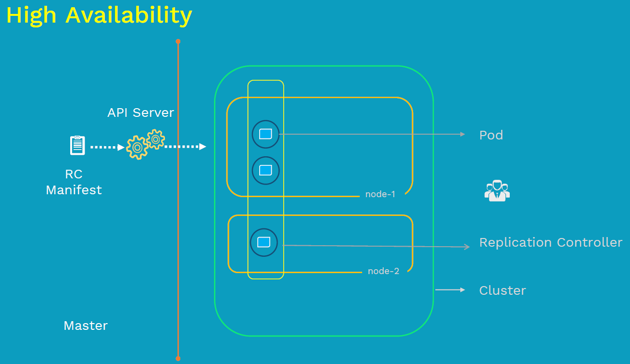
ReplicaSet Advantages
Replication Controller is older name of ReplicaSet
Raushan Kumar

Slide 44
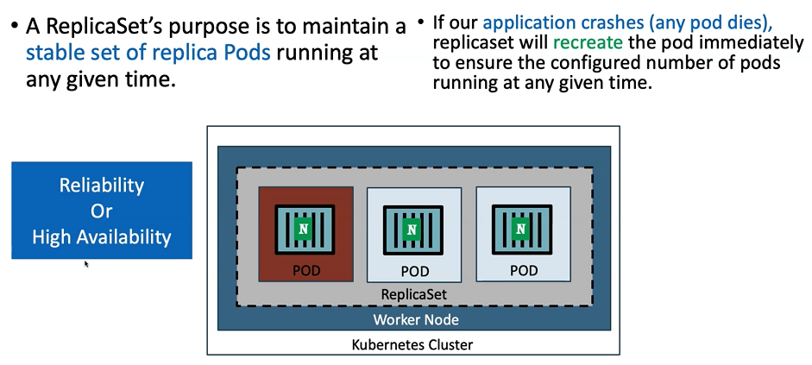
ReplicaSet Advantages
Raushan Kumar

Slide 45
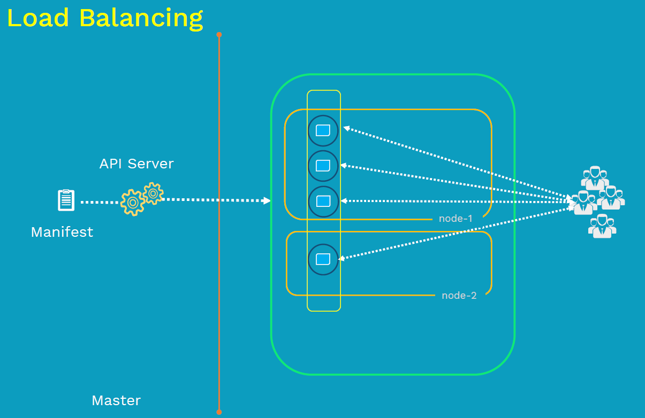
ReplicaSet Advantages
Raushan Kumar

Slide 46
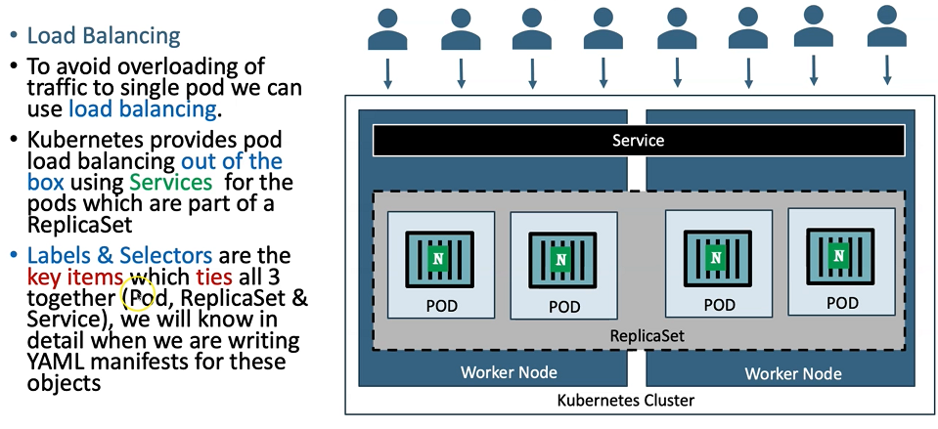
ReplicaSet Advantages
Raushan Kumar

Slide 47
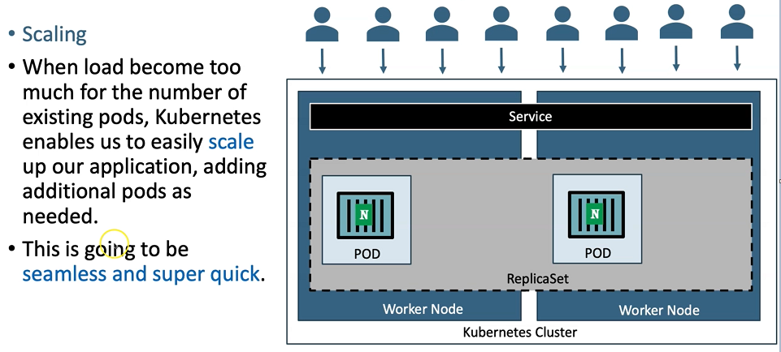
ReplicaSet Advantages
Raushan Kumar

Slide 48
Create ReplicaSet Definition
# nginx-rs.yaml
apiVersion: apps/v1
kind: ReplicaSet
metadata:
name: nginx-rs
spec:
replicas: 3
template:
metadata:
name: nginx-pod
labels:
app: nginx-app
tier: frontend
spec:
containers:
- name: nginx-container
image: nginx
ports:
- containerPort: 80
selector:
matchLabels:
app: nginx-app
matchExpressions:
- {key: tier, operator: In, values: [frontend]}
Create and display replicaset:
kubectl create -f nginx-rs.yaml
kubectl get po -o wide
kubectl get po -l app=nginx-app
kubectl get rs nginx-rs -o wide
kubectl describe rs nginx-rs
Automatic Pod Reschedule:
kubectl get po -o wide --watch
kubectl get po -o wide
kubectl get nodes
Scale up pods:
kubectl scale rs nginx-rs --replicas=5
kubectl get rs nginx-rs -o wide
kubectl get po -o wide
Scale down pods:
kubectl scale rs nginx-rs --replicas=3
kubectl get rs nginx-rs -o wide
kubectl get po -o wide
Cleanup:
kubectl delete -f nginx-rs.yaml
kubectl get rs
kubectl get po -l app=nginx-app
Raushan Kumar

Slide 49
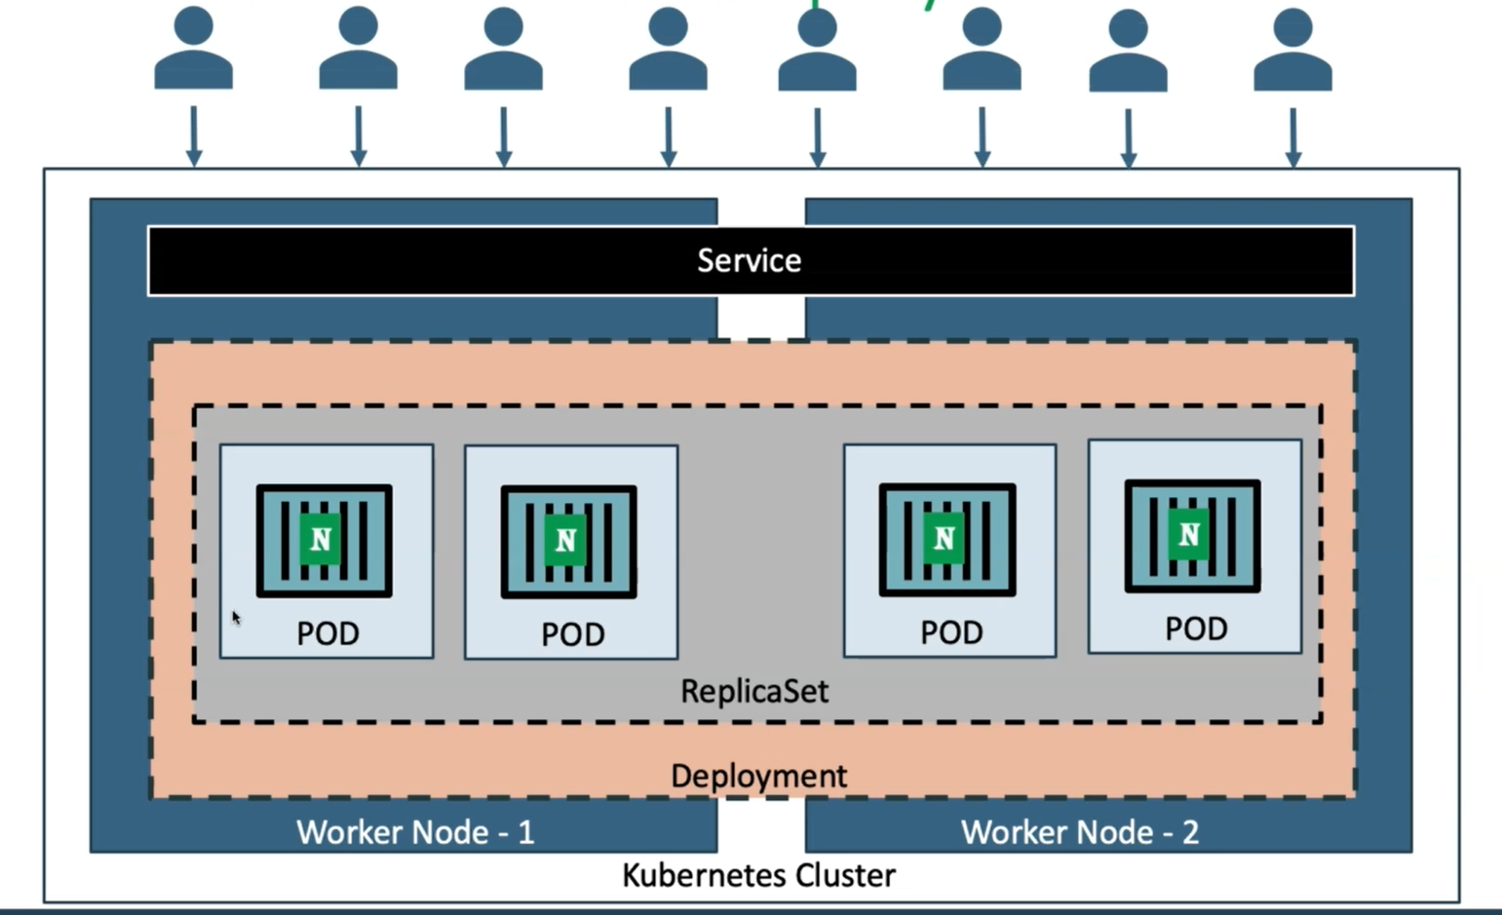
Deployment
Raushan Kumar

Slide 50
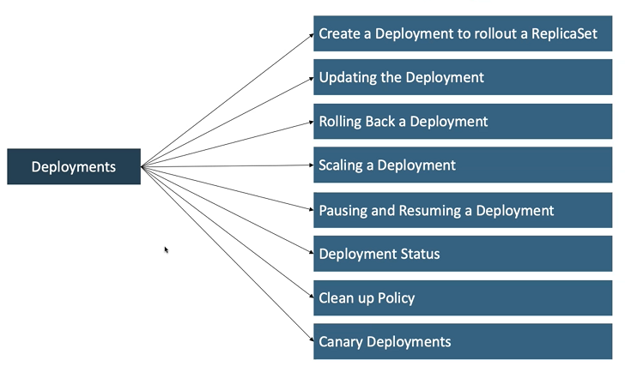
Deployment Features
Raushan Kumar

Slide 51
Create Deployment Definition
# nginx-deploy.yaml
apiVersion: apps/v1
kind: Deployment
metadata:
name: nginx-deploy
labels:
app: nginx-app
spec:
replicas: 3
template:
metadata:
labels:
app: nginx-app
spec:
containers:
- name: nginx-container
image: nginx:1.7.9
ports:
- containerPort: 80
selector:
matchLabels:
app: nginx-app
Create and Display Deployment:
kubectl create -f nginx-deploy.yaml
kubectl get deploy -l app=nginx-app
kubectl get rs -l app=nginx-app
kubectl get po -l app=nginx-app
kubectl describe deploy nginx-deploy
Testing: Rollback update:
kubectl set image deploy nginx-deploy nginx-container=nginx:1.91 --record
kubectl rollout status deployment/nginx-deploy
kubectl rollout history deployment/nginx-deploy
kubectl rollout undo deployment/nginx-deploy
kubectl rollout status deployment/nginx-deploy
kubectl describe deploy nginx-deploy | grep -i image
Testing: Update Version of "nginx:1.7.9" to "nginx:1.9.1"
kubectl set image deploy nginx-deploy nginx-container=nginx:1.9.1
kubectl edit deploy nginx-deploy
kubectl rollout status deployment/nginx-deploy
kubectl get deploy
Raushan Kumar

Slide 52
Create Deployment Definition Continued..
Testing: Scale UP:
kubectl scale deployment nginx-deploy --replicas=5
kubectl get deploy
kubectl get po -o wide
Testing: Scale DOWN:
kubectl scale deployment nginx-deploy --replicas=3
kubectl get deploy
kubectl get po -o wide
Cleanup:
kubectl delete -f nginx-deploy.yaml
kubectl get deploy
kubectl get rs
kubectl get po
Raushan Kumar

Slide 53
Types of Services
Raushan Kumar

Slide 54
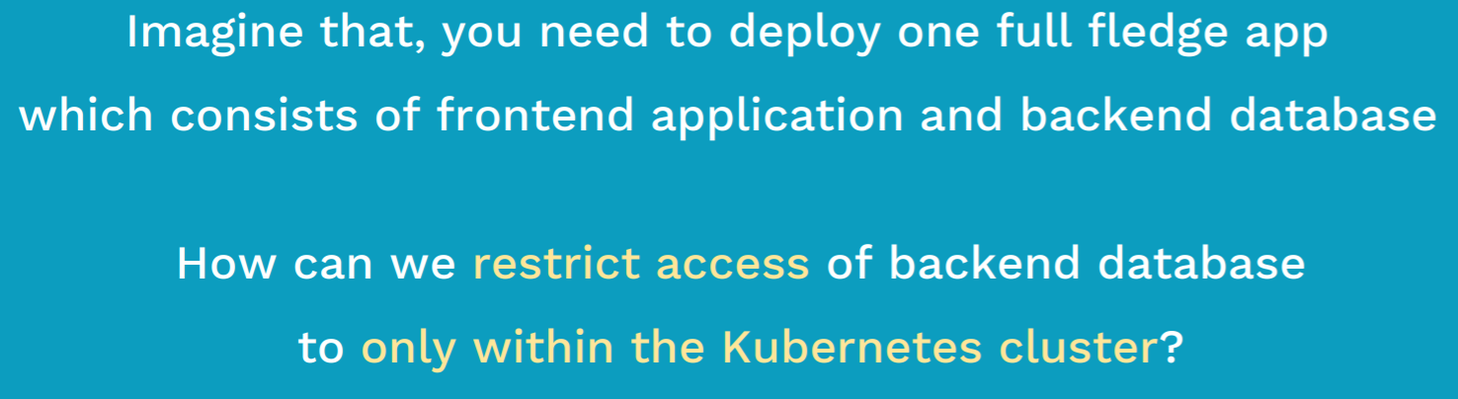
Why ClusterIP Service?
Raushan Kumar

Slide 55
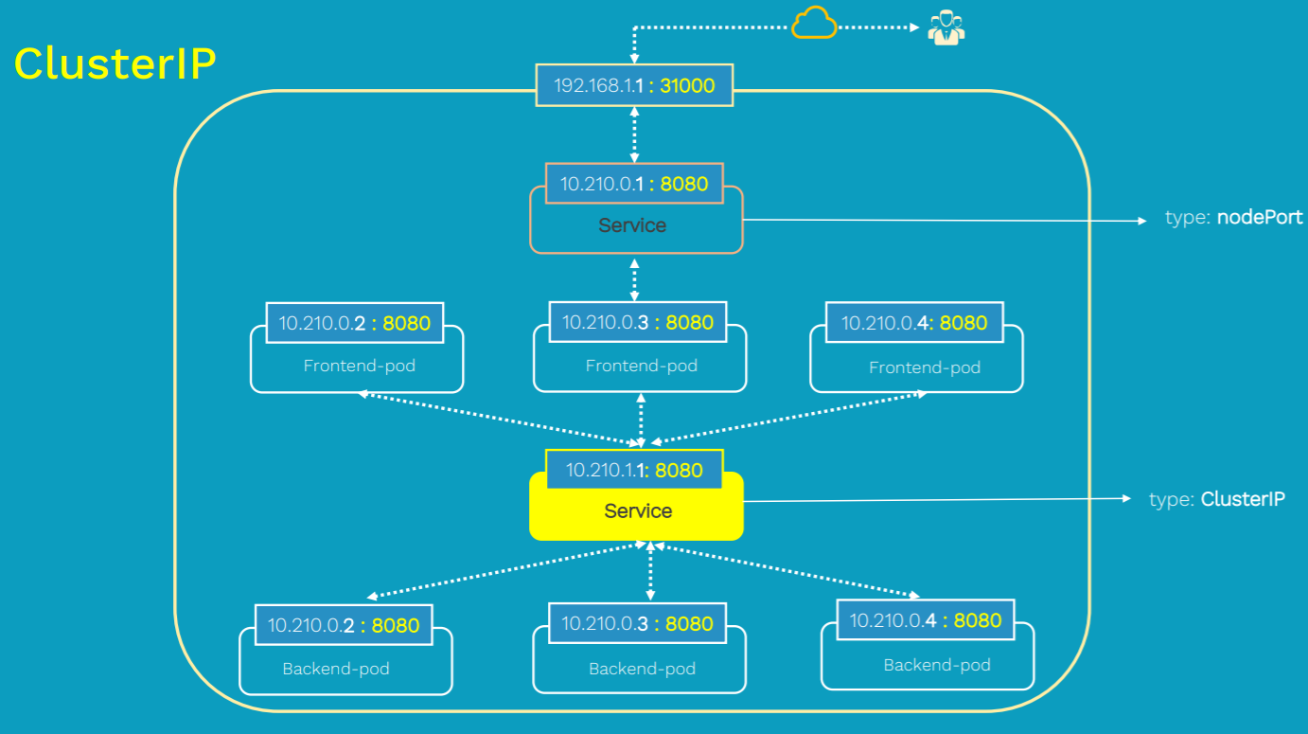
ClusterIP
Raushan Kumar

Slide 56

Why LoadBalancer service?
Raushan Kumar

Slide 57
Why LoadBalancer service?
Raushan Kumar

Slide 58

Problem
Raushan Kumar

Slide 59

LoadBalancer Service
Raushan Kumar

Slide 60

LoadBalancer Config
Raushan Kumar

Slide 61

EC2 Scaling - ASG
Raushan Kumar

Slide 62

Horizontal Pod Autoscaler (HPA)
Raushan Kumar

Slide 63

HPA Continued…
m stands for Millicore
Raushan Kumar

Slide 64

HPA Continued…
Raushan Kumar

Slide 65

HPA Continued…
Mi stands for Mebibytes
1 Mi = 1.048 MB (Megabytes)
Raushan Kumar

Slide 66

HPA Continued…
Raushan Kumar

Slide 67
HPA Demo
Install Metrics Server
Deploy Deployment, Service, HPA
Increase Load
Pod Scale!
Install Metrics Server
Verify Metric Server is installed or not:
kubectl get deployment metrics-server -n kube-system
Deploy the Metric Server:
kubectl apply -f https://github.com/kubernetes-sigs/metrics-server/releases/latest/download/components.yaml
Raushan Kumar

Slide 68
HPA Demo Continued..
Deploy Deployment, Service, HPA:
https://kubernetes.io/docs/tasks/run-application/horizontal-pod-autoscale-walkthrough/
Increase Load
Pod Scale!
Related Commands: kubectl get hpa
Kubectl get rs - To observe replicaset values getting updated with load
Kubectl get pods
Raushan Kumar

Slide 69

EKS Cluster Autoscaler
Raushan Kumar

Slide 70

Cluster Autoscaler
Raushan Kumar

Slide 71

Cluster Autoscaler
Raushan Kumar

Slide 72

EKS Cluster Autoscaler Demo
https://docs.aws.amazon.com/eks/latest/userguide/cluster-autoscaler.html
eksctl create cluster --name <my-cluster> --version <1.17> --managed --asg-access
Raushan Kumar

Slide 73
Cluster autoscaler – Deploy
1. Deploy the Cluster Autoscaler to your cluster with the following command: kubectl apply -f https://raw.githubusercontent.com/kubernetes/autoscaler/master/
cluster-autoscaler/cloudprovider/aws/examples/cluster-autoscaler-autodiscover.yaml
2. Add the cluster-autoscaler.kubernetes.io/safe-to-evict annotation to the deployment with the following command:
kubectl -n kube-system annotate deployment.apps/cluster-autoscaler clusterautoscaler.
kubernetes.io/safe-to-evict="false“
kubectl -n kube-system annotate deployment.apps/cluster-autoscaler clusterautoscaler.
kubernetes.io/safe-to-evict="false“ --overwrite
3. Edit the Cluster Autoscaler deployment with the following command: (Refer EKS Documentation) kubectl -n kube-system edit deployment.apps/cluster-autoscaler
Edit the cluster-autoscaler container command to replace <YOUR CLUSTER NAME> with your
cluster's name, and <Your Kubernetes version>
kubectl -n kube-system describe deployment.apps/cluster-autoscaler – Check the deployment
Raushan Kumar

Slide 74
EKS Cluster Autoscaler Demo
Edit the ASG correctly
Deploy the manifest in the cluster
Observe in Auto Scaling Group – Nodes Scaling Up..
Kubectl delete deployment <deployment-name>
Nodes will scale down as per the cooldown period.
kubectl –n kube-system logs deployment.apps/cluster-autoscaler – To Check the logs of autoscaler
Raushan Kumar

Slide 75

Container Insights
Raushan Kumar

Slide 76

Container Insights
Raushan Kumar

Slide 77

Enable Container Insights
https://docs.aws.amazon.com/AmazonCloudWatch/latest/monitoring/Container-Insights-setup-EKS-quickstart.html
1. IAM Role: GoTo the EC2-IAM Section and Click. Attach “CloudWatchLogsFullAccess” Policy
2. Execute this Command: Replace cluster_name & region_name with yours.
curl https://raw.githubusercontent.com/aws-samples/amazon-cloudwatch-container-insights/latest/k8s-deployment-manifest-templates/
deployment-mode/daemonset/container-insights-monitoring/quickstart/cwagent-fluentd-quickstart.yaml | sed "s/{{cluster_name}}/
ekstest2/;s/{{region_name}}/eu-central-1/" | kubectl apply -f –
Deleting Container Insights
curl https://raw.githubusercontent.com/aws-samples/amazon-cloudwatch-container-insights/latest/k8s-deployment-manifest-templates/
deployment-mode/daemonset/container-insights-monitoring/quickstart/cwagent-fluentd-quickstart.yaml | sed "s/{{cluster_name}}/
ekstest2/;s/{{region_name}}/eu-central-1/" | kubectl delete -f –
Raushan Kumar

Slide 78

Q & A
Raushan Kumar
Notes:
In Slide Show mode, select the arrows to visit links.

Slide 79
Thank You!
Raushan Kumar

